Slide 1
2D Geometric Transformations

Slide 2
Contents
Definition & Motivation
2D Geometric Transformation
  Translation
  Rotation
  Scaling
Matrix Representation
Homogeneous Coordinates
Matrix Composition
Composite Transformations
  Pivot-Point Rotation
  General Fixed-Point Scaling
  Reflection and Shearing
  Transformations Between Coordinate Systems

Slide 3
Geometric Transformation
Definition
  Translation, Rotation, Scaling
Motivation – Why do we need geometric transformations in CG?
  As a viewing aid
  As a modeling tool
  As an image manipulation tool

Slide 4
Example: 2D Geometric Transformation
Modeling
Coordinates
World Coordinates

Slide 5
Example: 2D Scaling
Modeling
Coordinates
Scale(0.3, 0.3)
World Coordinates

Slide 6
Example: 2D Rotation
Modeling
Coordinates
Scale(0.3, 0.3)
Rotate(-90)
World Coordinates

Slide 7
Example: 2D Translation
Modeling
Coordinates
Scale(0.3, 0.3)
Rotate(-90)
Translate(5, 3)
World Coordinates

Slide 8
Example: 2D Geometric Transformation
Modeling
Coordinates
Again?
World Coordinates

Slide 9
Example: 2D Geometric Transformation
Modeling
Coordinates
Scale
Translate
Scale
Rotate
Translate
World Coordinates

Slide 10







Basic 2D Transformations
Translation ( P’ = P + T )
Scale
Rotation
  y’= x sin θ + y cos θ
Shear

Slide 11
Basic 2D Transformations
Translation
Scale
Rotation
  y’= x sin θ + y cos θ
Shear
Transformations
can be combined
(with simple algebra)

Slide 12
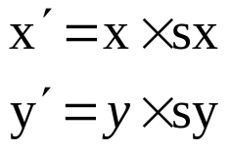
Basic 2D Transformations
Translation
Scale
Rotation
Shear
y’= x sin θ + y cos θ

Slide 13
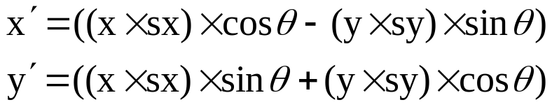
Basic 2D Transformations
Translation
Scale
Rotation
Shear
y’= x sin θ + y cos θ

Slide 14
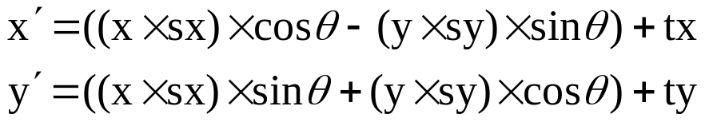
Basic 2D Transformations
Translation
Scale
Rotation
Shear
y’= x sin θ + y cos θ

Slide 15
Basic 2D Transformations
Translation
Scale
Rotation
Shear
y’= x sin θ + y cos θ

Slide 16
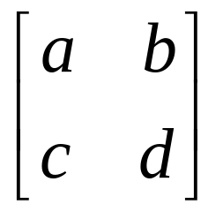
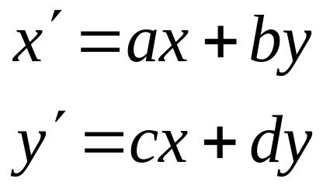
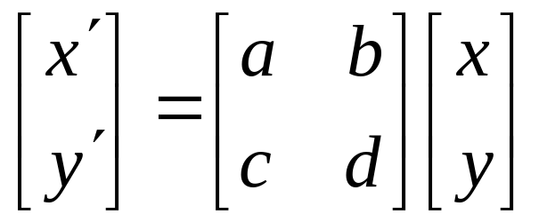
Matrix Representation
Represent a 2D Transformation by a Matrix
Apply the Transformation to a Point
Transformation
Matrix
Point

Slide 17
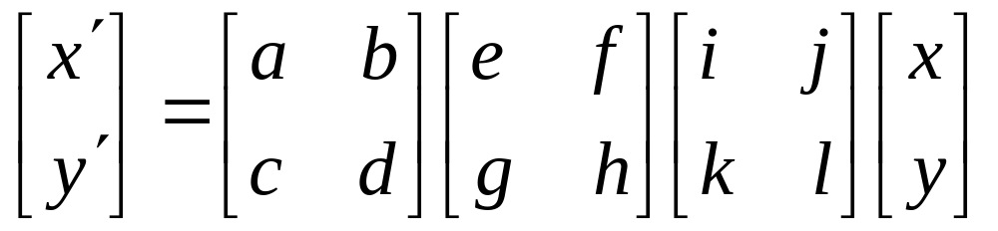
Matrix Representation
Transformations can be combined by matrix multiplication
Transformation
Matrix
Matrices are a convenient and efficient way
to represent a sequence of transformations

Slide 18
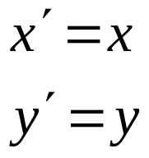
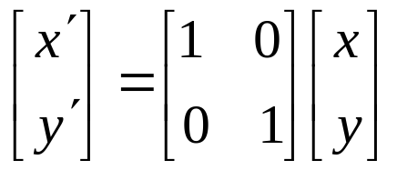
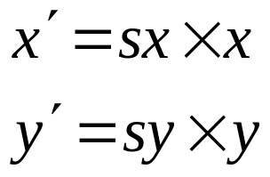
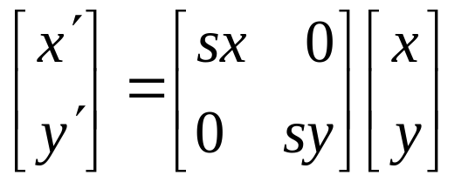
2D Scaling
What types of transformations can be represented with a 2×2 matrix?
2D Identity
2D Scaling

Slide 19
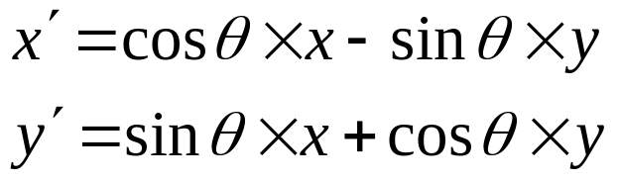
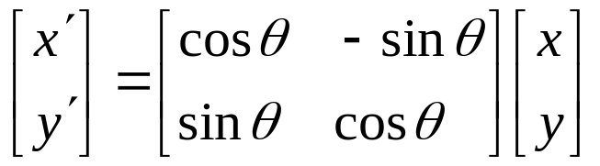
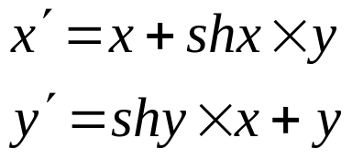
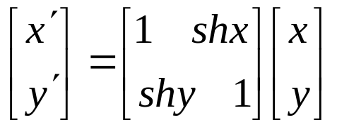
2D Rotation and Shear
What types of transformations can be represented with a 2×2 matrix?
2D Rotation
2D Shearing

Slide 20
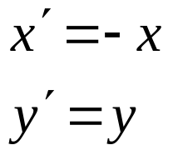
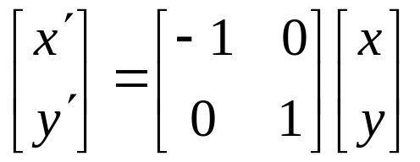
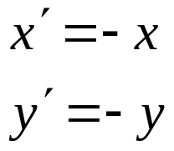
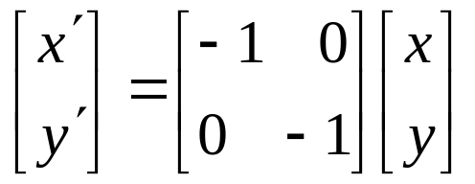
2D Reflection
What types of transformations can be represented with a 2×2 matrix?
2D Mirror reflection over Y axis
2D Mirror reflection over (0,0)Co-ordinate origin

Slide 21
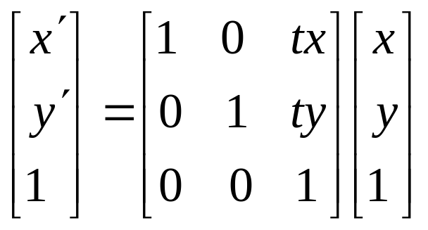
2D Translation
2D translation can be represented by a 3×3 matrix
  Point represented with homogeneous coordinates

Slide 22
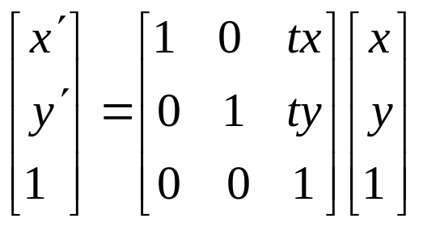
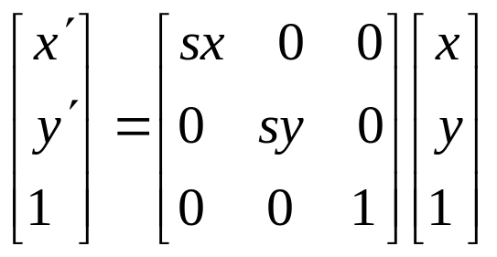
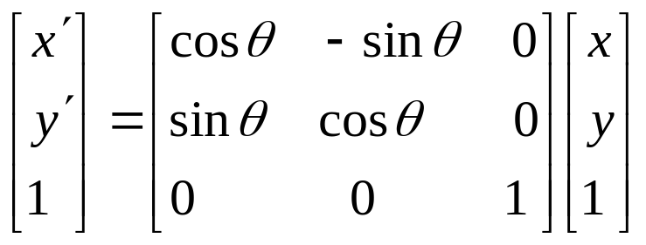
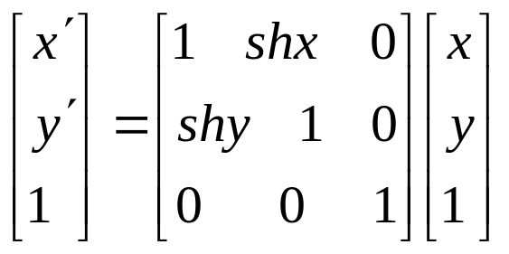
Basic 2D Transformations
Basic 2D transformations as 3x3 Matrices
Translate
Scale
Rotate
Shear

Slide 23
OpenGL for Translation
glTranslate * ( tx, ty, tz);
tx, ty,tz can be assigned any real number values
* is single suffix code is either f(float) or d (double)
For 2D – we set, tz = 0 ;
Ex: glTranslatef ( 25.0, -10.0, 0.0);
Translate subsequently defined co-ordinate positions 25 units in x-direction and -10 units in y-direction.

Slide 24
OpenGL for Rotation
glRotate * ( theta, vx, vy, vz);
Vector v =( vx,v,vz) can have any floating point values , defines the orientation for a rotation axis that passes through the origin.
* is single suffix code is either f(float) or d (double)
Theta is rotation angle in degrees.( + is CCW and – is CW).
Ex: glRotatef ( 90.0, 0.0, 0.0, 1.0);\\90 degree rotation about the z-axis.

Slide 25
OpenGL for Scaling
glScale * ( sx, sy, sz);
sx, sy,sz can be assigned any real number values
* is single suffix code is either f(float) or d (double)
Ex: glScalef ( 2.0, -3.0, 1.0);
.

Slide 26
OpenGL Model View Matrix
glMatrixMode ( GL_MODEL VIEW);
Defalut argument for glmatrixmode is GL_MODELVIEW
Used to store and combine the geometric transformations.

Slide 27
Homogeneous Coordinates
Add a 3rd coordinate to every 2D point
  (x, y) is converted to (x_{h}, y_{h}, h)
  where x = (x_{h} /h), y = (y_{h} /h)
  (x,y) = ( h.x , h.y, h)
  (x, y, 0) represents a point at infinity
  (0, 0, 0) Is not allowed
y
1
(2, 1, 1) or (4, 2, 2) or (6, 3, 3)
x
1
2
Convenient Coordinate System to
Represent Many Useful Transformations

Slide 28
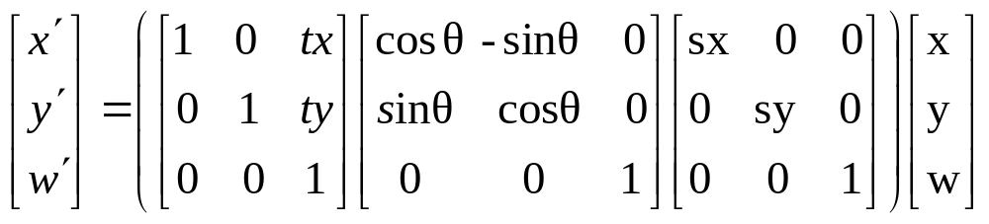





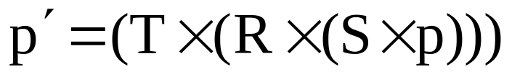
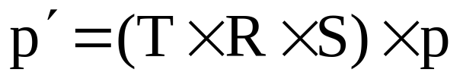
Matrix Composition
Transformations can be combined by matrix multiplication
Efficiency with premultiplication
  Matrix multiplication is associative

Slide 29


Matrix Composition
Rotate by θ around arbitrary point (a,b)
Scale by sx, sy around arbitrary point (a,b)
(a,b)
(a,b)

Slide 30
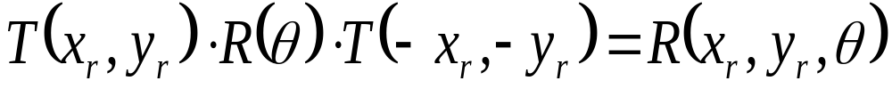
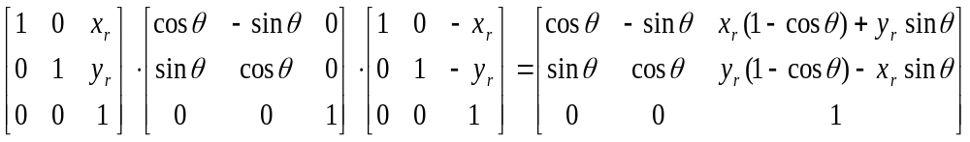
General Pivot-Point Rotation
(x_{r},y_{r})
(x_{r},y_{r})
(x_{r},y_{r})
(x_{r},y_{r})
Translate
Rotate
Translate

Slide 31
Steps : Gen Pivot Point Rotation
Translate the object so that pivot position is moved to origin
Rotate the object about the co-ordinate origin
Translate the object so that pivot is returned to the original position

Slide 32
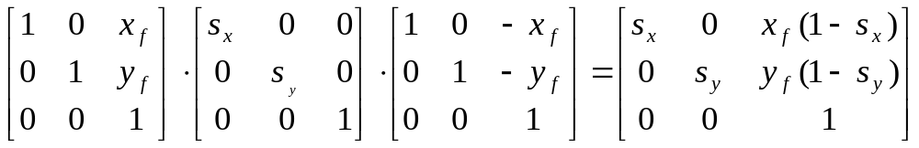
General Fixed-Point Scaling
(x_{f},y_{f})
(x_{f},y_{f})
(x_{f},y_{f})
(x_{f},y_{f})
Translate
Scale
Translate

Slide 33
Steps: Gen Fixed Point Scaling
Translate the object so that fixed point coincides with the origin
Scale the object w.r.t co-ordinate origin
Use inverse Translation of step 1 to return the object to its original position

Slide 34
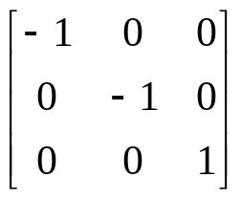
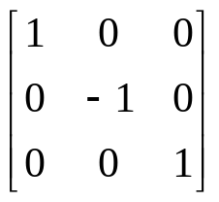
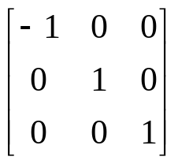
Reflection
Reflection with respect to the axis
• Refl abt x-axis Refl abt y-axis Refl -axis perpen x-same, y-flips x-flips, y-same to xy- plane
x-flips, y-flips
y
1
y
y
1
1’
1’
2
3
2
3
3’
2
3’
2
x
x
3
x
2’
3’
1
1’
2

Slide 35
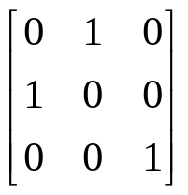
Reflection
Reflection with respect to a Line
Clockwise rotation of 45 → Reflection about the x axis → Counterclockwise rotation of 45
y
x
y=x
y
y
1
y
2
3
x
2’
3’
x
x
1’

Slide 36
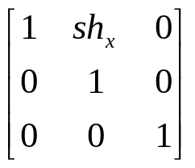
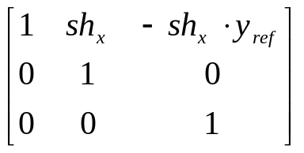
Shear
Unit sqare Converted to a parallelogram with
x’ = x + shx · y, y’ = y
Transformed to a shifted parallelogram
  (Y = Yref)
x’ = x + shx · (y-yref), y’ = y
(Shx=2)
y
(1,1)
y
(0,1)
(2,1)
(3,1)
(0,0)
x
x
(1,0)
(0,0)
(1,0)
(Shx=2)
y
y
(2,1)
(0,1)
(1,1)
(1,1)
(1/2,0)
x
x
(0,0)
(1,0)
(3/2,0)
(0,-1)
(Shx=1/2, yref=-1)

Slide 37
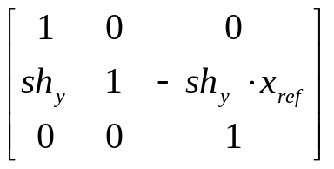
Shear
Y-direction shear relative to line (X = Xref)
x’ = x, y’ = shy · (x-xref) + y
(0,3/2)
(1,2)
y
y
(0,1)
(1,1)
(0,1/2)
(1,1)
(0,0)
(1,0)
x
x
(-1,0)
(Shy=1/2, xref=-1)

